Slide 1
Welcome! Thank you for joining us today. Please take a moment to introduce yourself in the chat function.
All participants have been muted. If you have a question during the presentation, please enter it into the chat function and we will respond to it during the meeting.
A copy of the workshop presentation will be uploaded to the project website after the call
If you have any technical questions during the presentation, please send a private message in the chat function to Alicia Flammia or email her at aflammia@brsinc.com
Before we begin...
Imagine Orem: Reinventing Brownfields

Slide 2
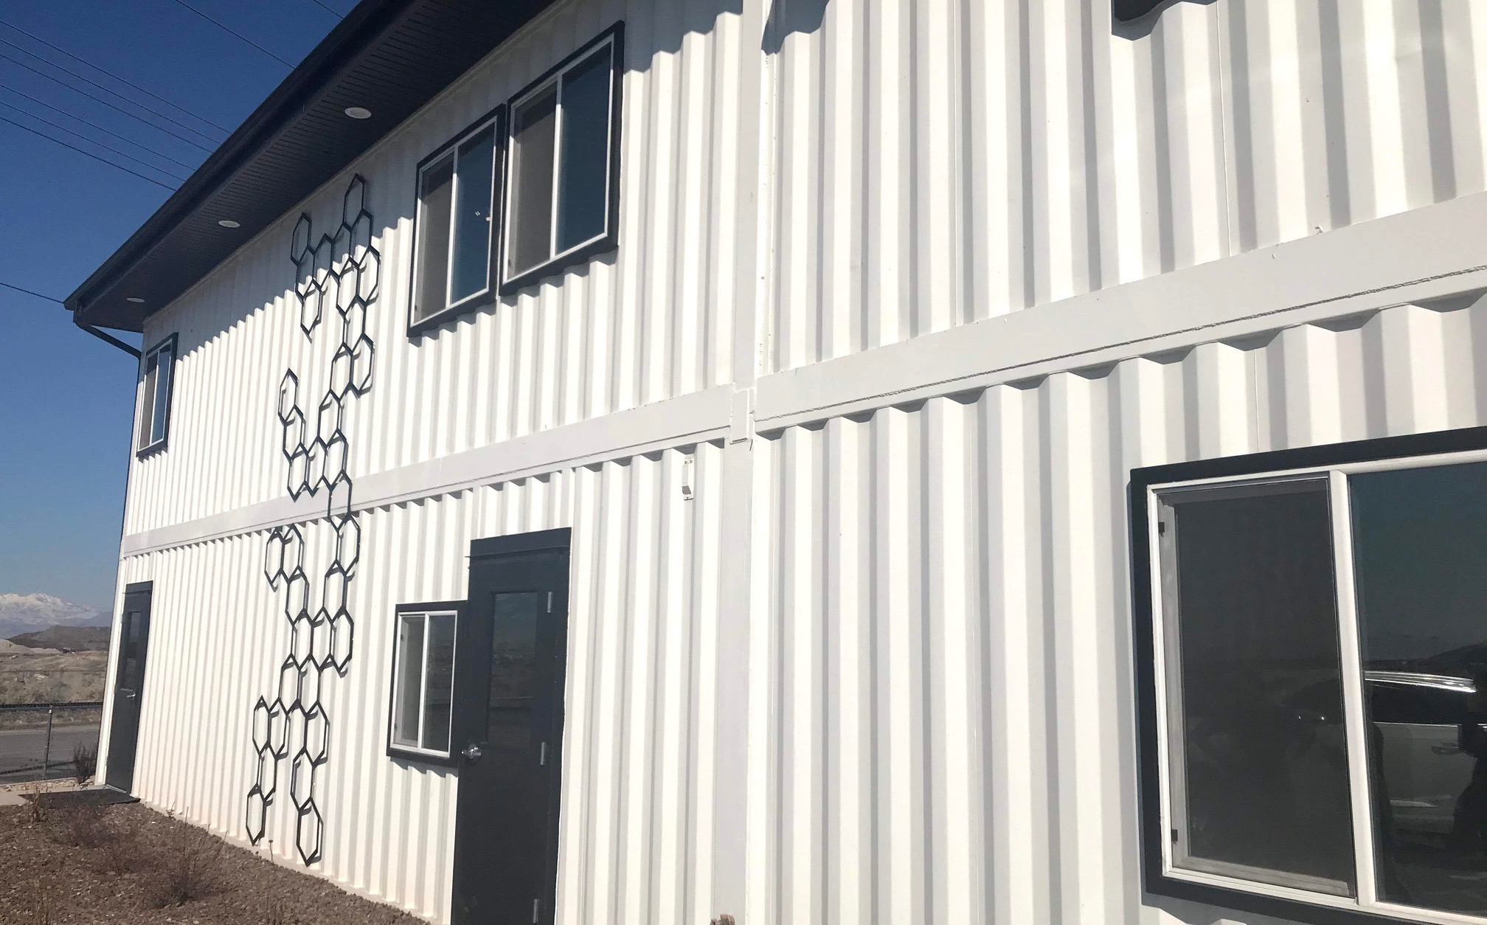
Imagine Orem:
Reinventing
Brownfields
PUBLIC WORKSHOP
OCTOBER 29, 2020

Slide 3
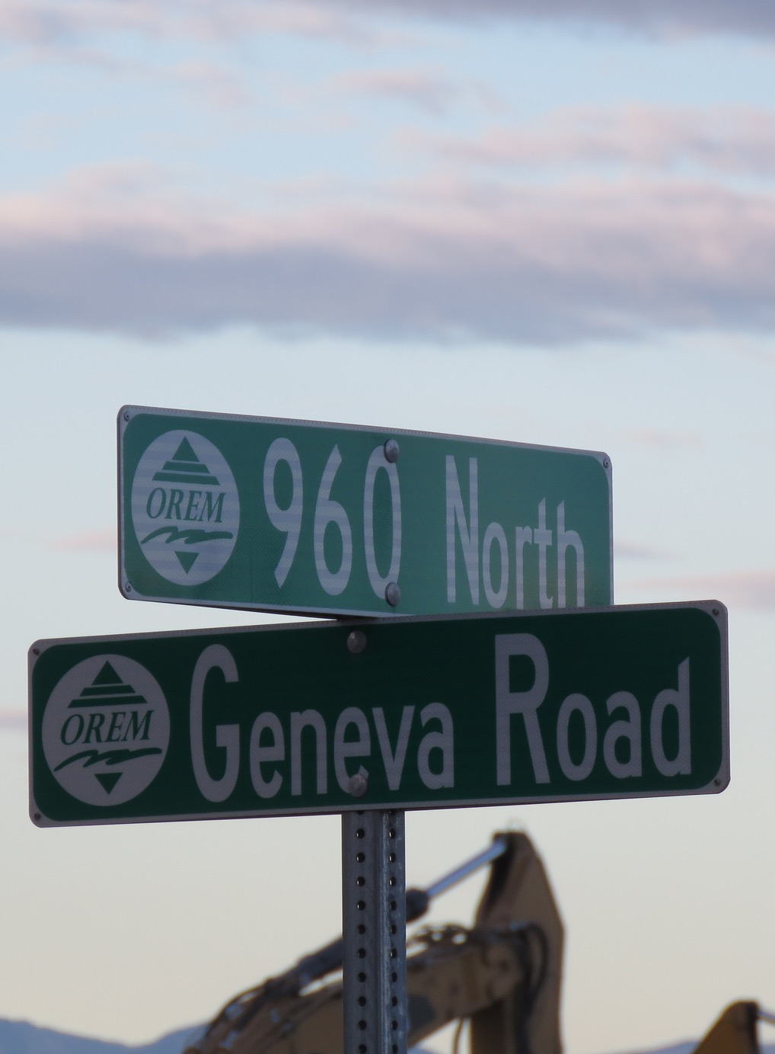
Meeting Outline
Topics to Discuss
IMAGINE OREM: REINVENTING BROWNFLEIDS
Opening Remarks
Introduction to the Project Team
Where have we been and where are we going?
Brownfields 101
Eligible Uses of Grant Funds
Next Steps

Slide 4
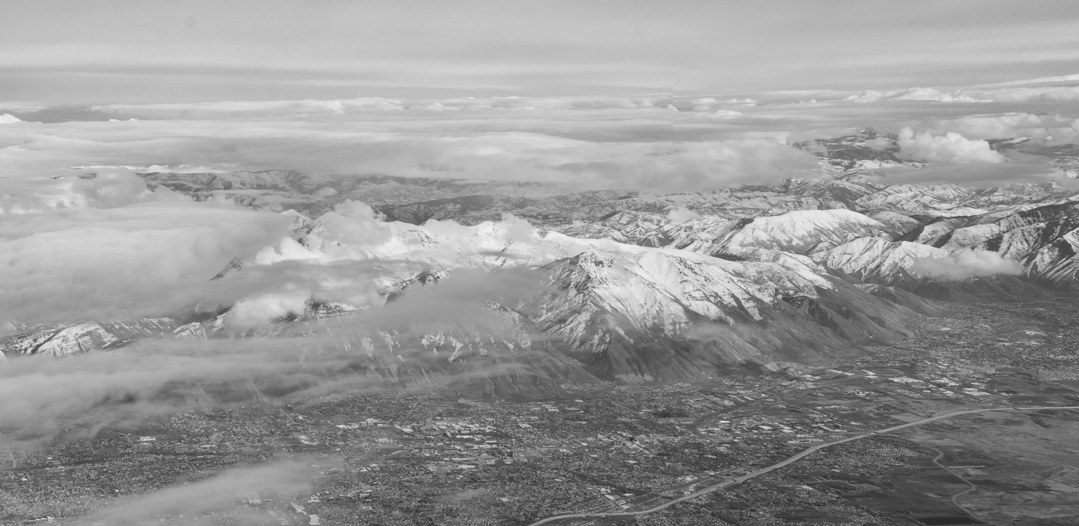
Poll Question #1
What is your role in the community?
PLEASE SELECT YOUR ANSWER

Slide 5
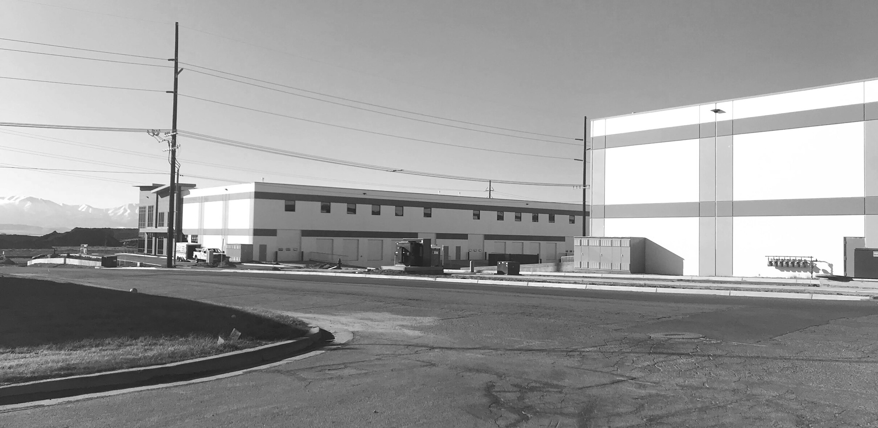
Introduction to the
Project Team

Slide 6
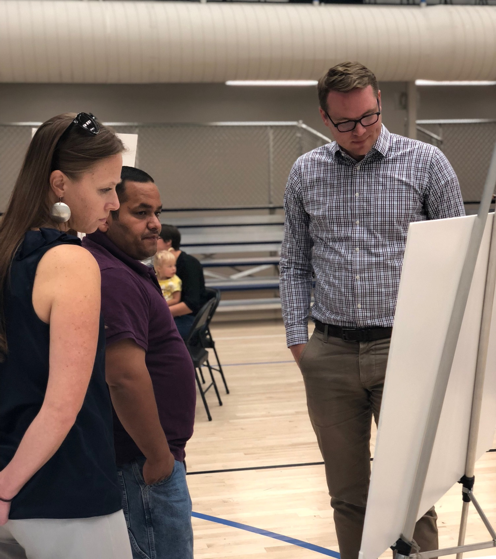
Introduction to the Project Team
IMAGINE OREM: REINVENTING BROWNFLEIDS
City of Orem, Planning Divison
The City of Orem's Planning Division is leading implementation of this project.
Matt Taylor, Long-Range Planner is serving as the Project Manager.

Slide 7
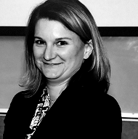
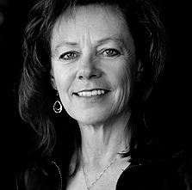
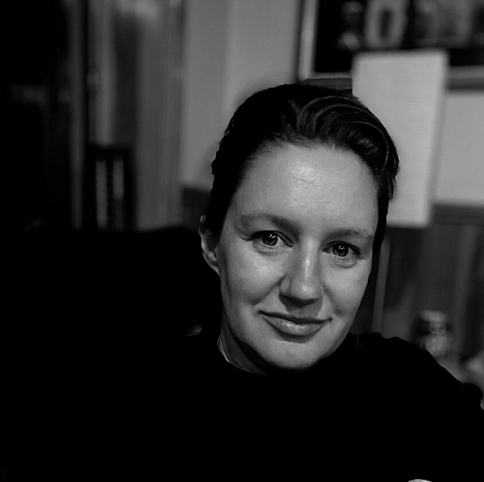
Consultant Team
BRS, Inc. and Wasatch Environmental are assisting the City of Orem with establishing a sustainable brownfield assessment program for the Geneva Road and State Street Corridor.
IMAGINE OREM: REINVENTING BROWNFLEIDS
JENNIFER TAYLOR
JULIE KILGORE
Jen is a professional engineer with BRS, Inc. She manages the consultant team and provides oversight for all aspects of the environmental work.
With over 25 years of experience, Julie serves as the President of Wasatch Environmental, whose team is performing environmental site work.
KATIE-ROSE IMBRIANO
Katie-Rose is an urban planner and grant manager with BRS, Inc. who is providing grant management and planning support to the City of Orem.

Slide 8
Our Partners
Advisory Committee Members
IMAGINE OREM: REINVENTING BROWNFLEIDS
City of Orem
City of Vineyard
Utah Department of Environmental Quality
Utah Department of Transportation
Utah Transit Authority
Utah Valley University
Economic Development Corporation of Utah
Mountainland Association of Governments Utah County Board of Health
With support from the USEPA

Slide 9
Where have we been and where are we going?

Slide 10
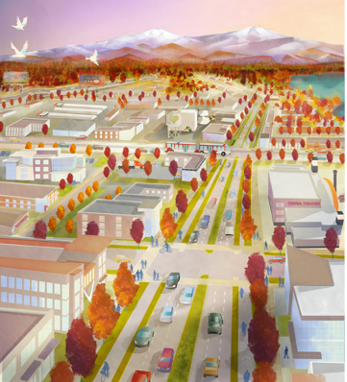
Where have we been?
IMAGINE OREM: REINVENTING BROWNFLEIDS
A Brief Background
Imagine Orem: State Street (2018)
Imagine Orem: Geneva Road (2019)
IMAGINE OREM: GENEVA ROAD POSTER

Slide 11
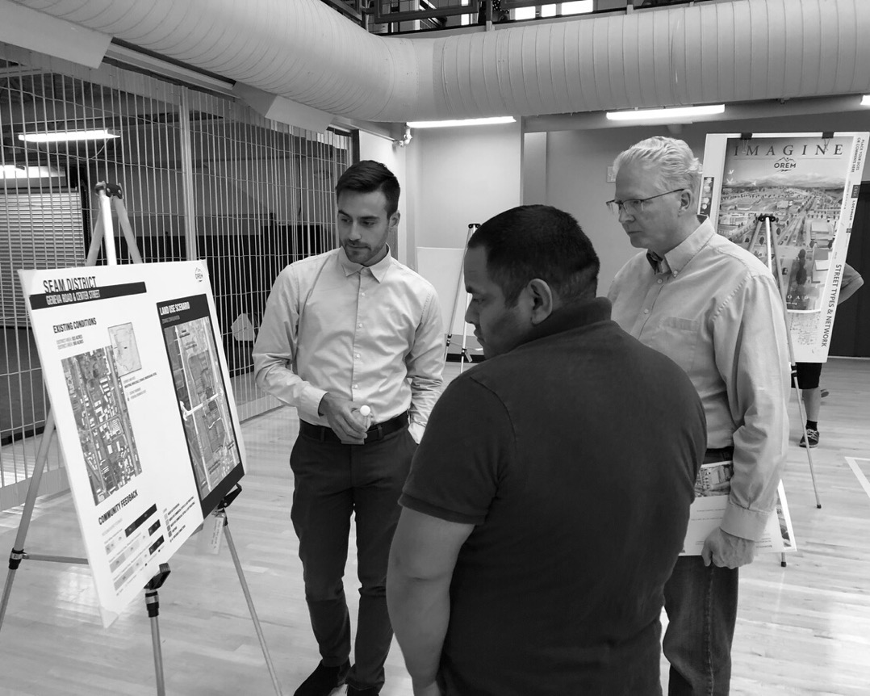
For the Community
In 2015 the City Council adopted the State Street Corridor Master Plan. This plan anticipates the redevelopment of key sites on State Street to support an overall vision of an attractive corridor that
fosters successful businesses,
creates a healthy and beautiful downtown center, and
is safe environment for people using several modes of transportation.
In 2018, the City launched the “Imagine Orem” campaign to provide multiple opportunities for the public to weigh in on plan implantation.
IMAGINE OREM: REINVENTING BROWNFLEIDS
By the Community
The 2019, the City approved the Imagine Orem: Geneva Road Plan. This is a community-driven vision and master plan for the renewal of Geneva Road to improve the health, safety, environmental quality, employment opportunities, transportation options, and business development in the Geneva Road corridor.

Slide 12
Why focus on brownfields?
JOBS AND TAX BASE
Brownfield sites are typically situated in commercial and industrial districts within the city. It is important to support both existing business owners and provide space for new commercial and light industrial businesses that will employ Orem residents and support the city's tax base.
IMAGINE OREM: REINVENTING BROWNFLEIDS
PUBLIC HEALTH
Historic commercial and industrial operations have left some properties along Geneva Road and State street both vacant and blighted. In addition, there may be contamination from these past uses in the groundwater and soil. By assessing these sites, we can understand and begin to address these environmental concerns.
Good for business, public health and the environment.

Slide 13
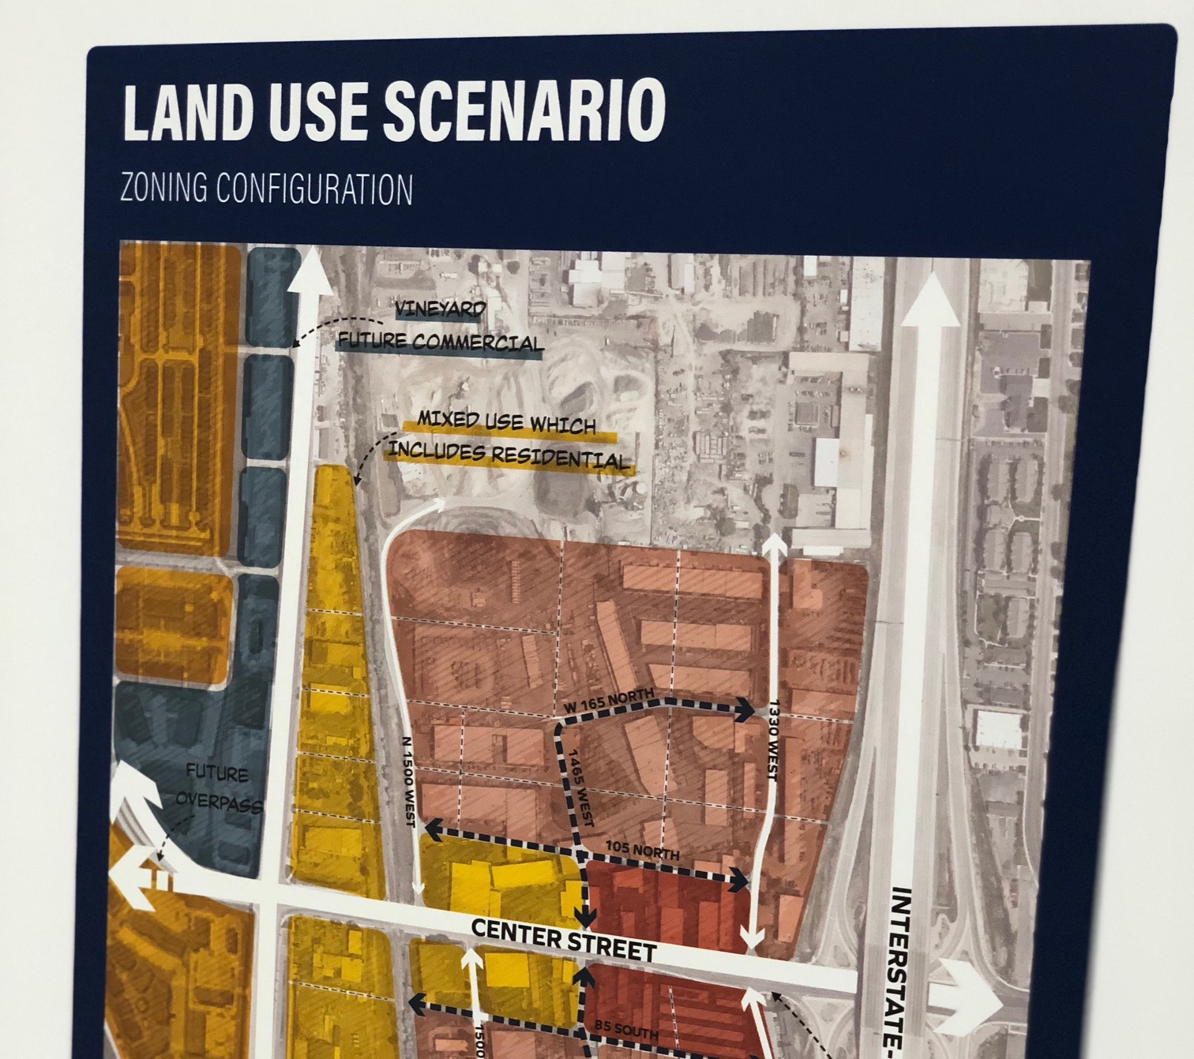
Where are we going?
Orem receives a new grant
IMAGINE OREM: REINVENTING BROWNFLEIDS
At the last public meeting for Imagine Orem: Geneva Road in 2019, the City announced that it had applied for a $300,000 grant to begin implementation of that plan and to assess brownfield sites citywide, with a focus on Geneva Road and State Street.
This funding was awarded in May 2019.

Slide 14
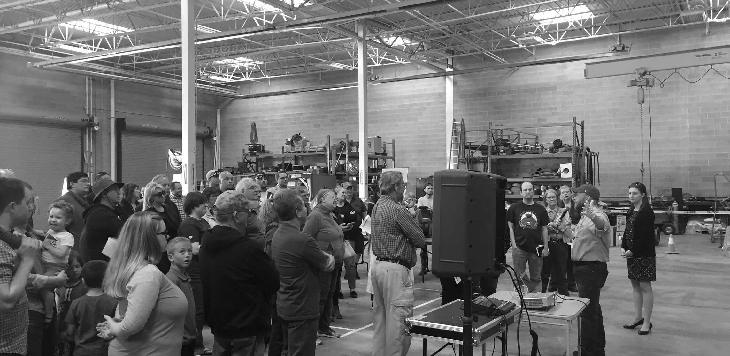
Poll Question #2
Have you previously attended a meeting for
State Street or Geneva Road?
PLEASE SELECT YOUR ANSWER

Slide 15
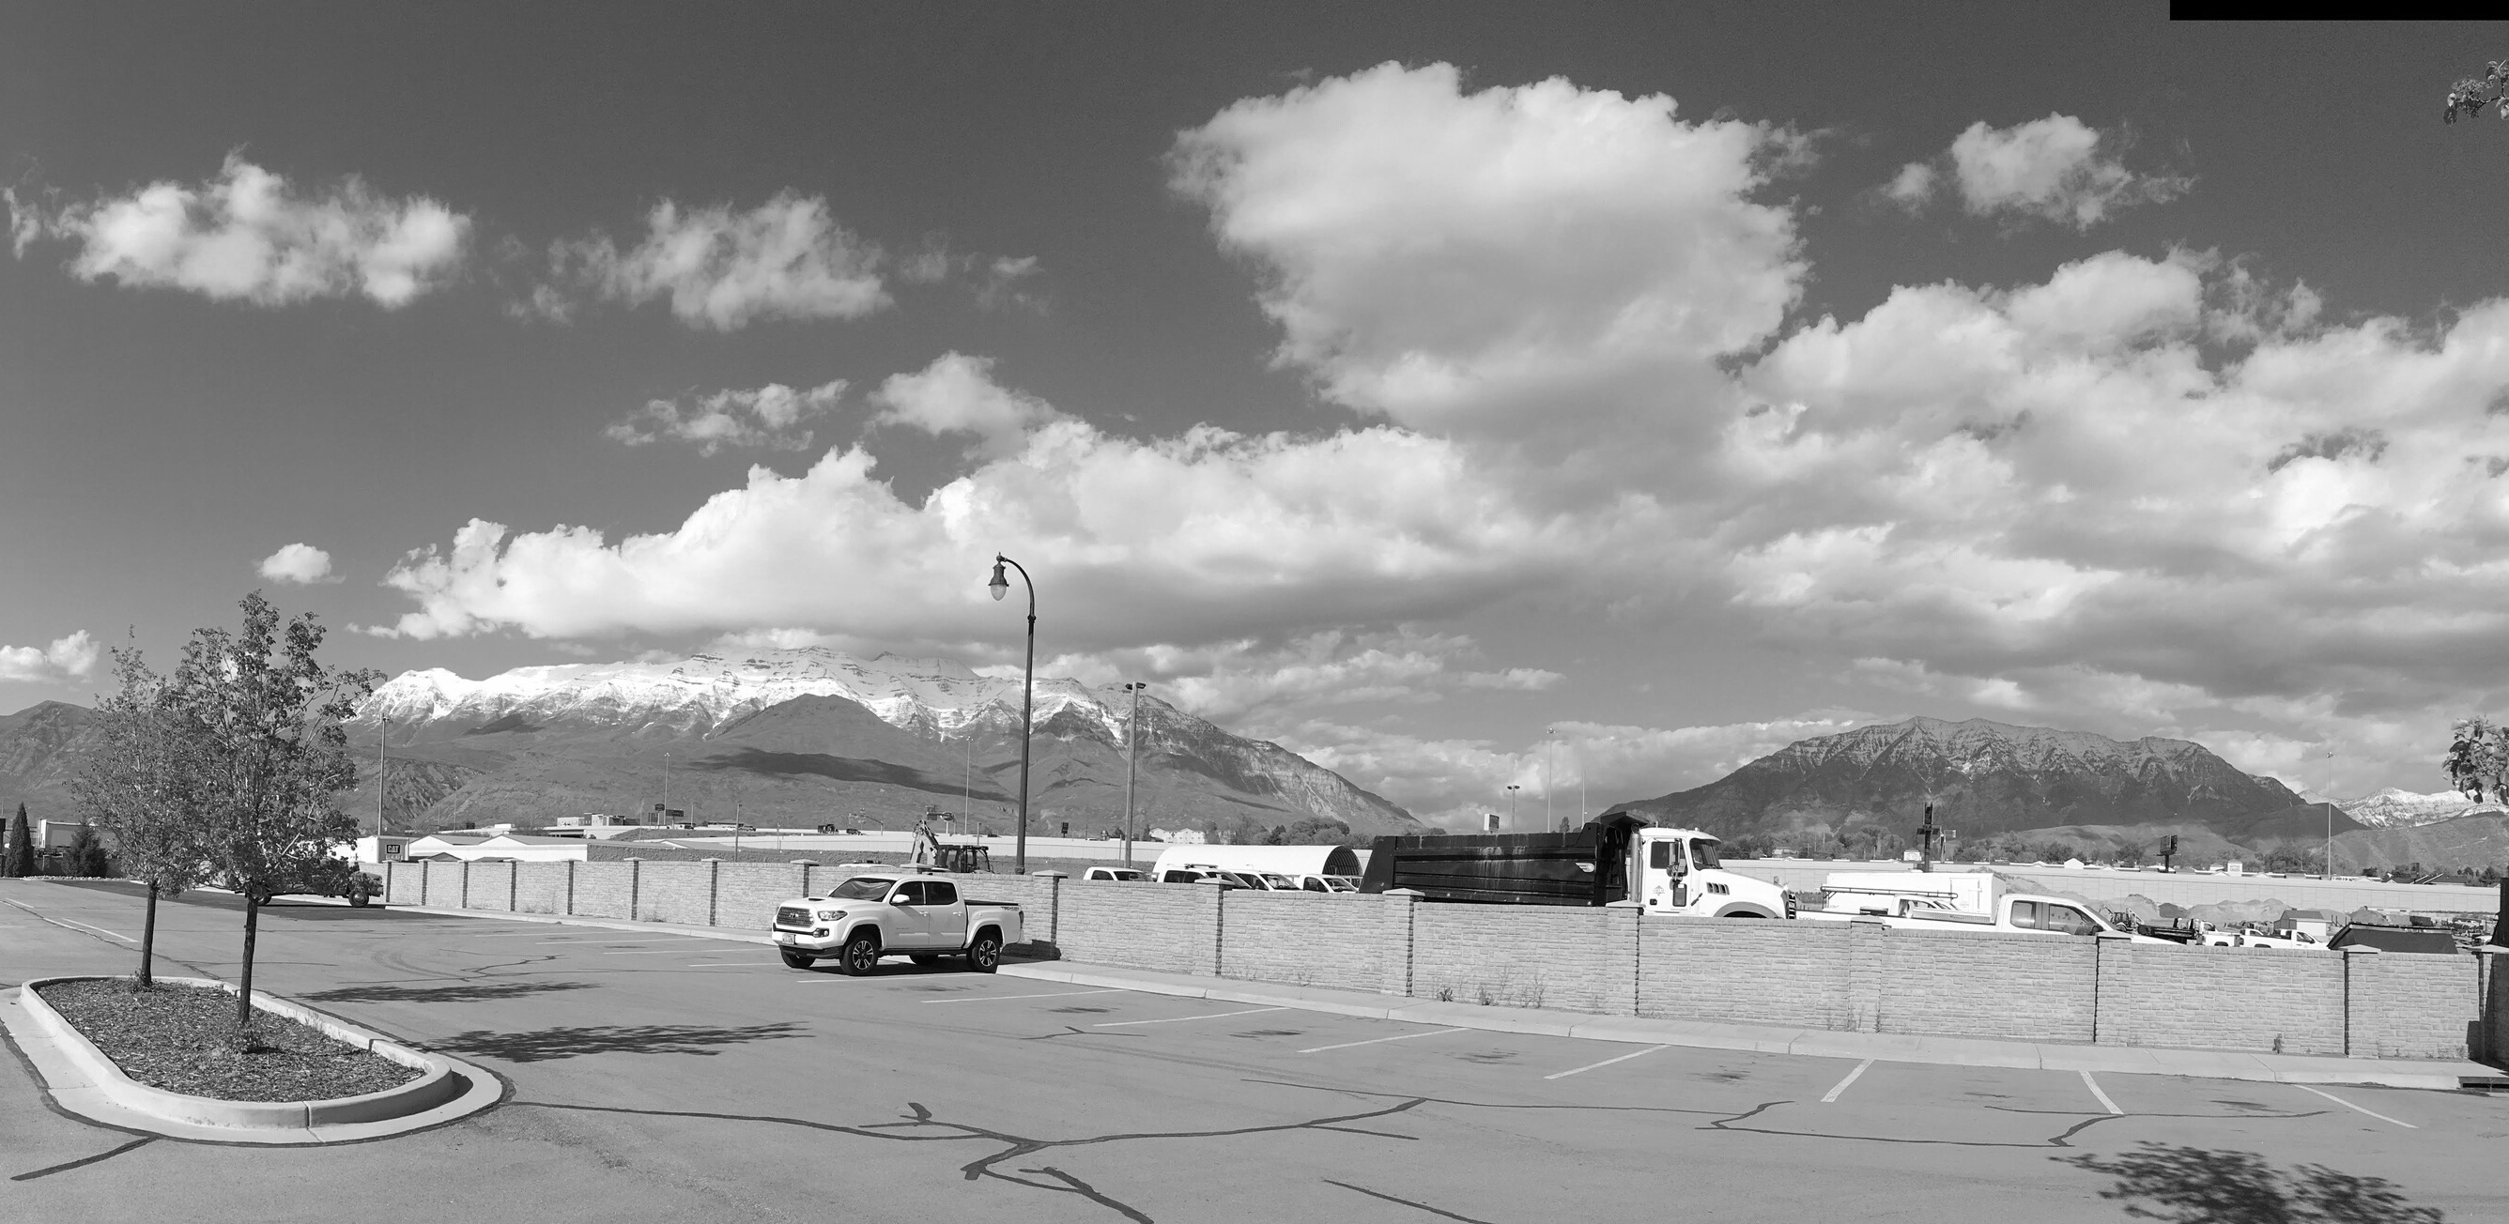
Poll Question #3
What do you love about living in Orem and why?
PLEASE ENTER YOUR RESPONSE IN THE CHAT BOX

Slide 16
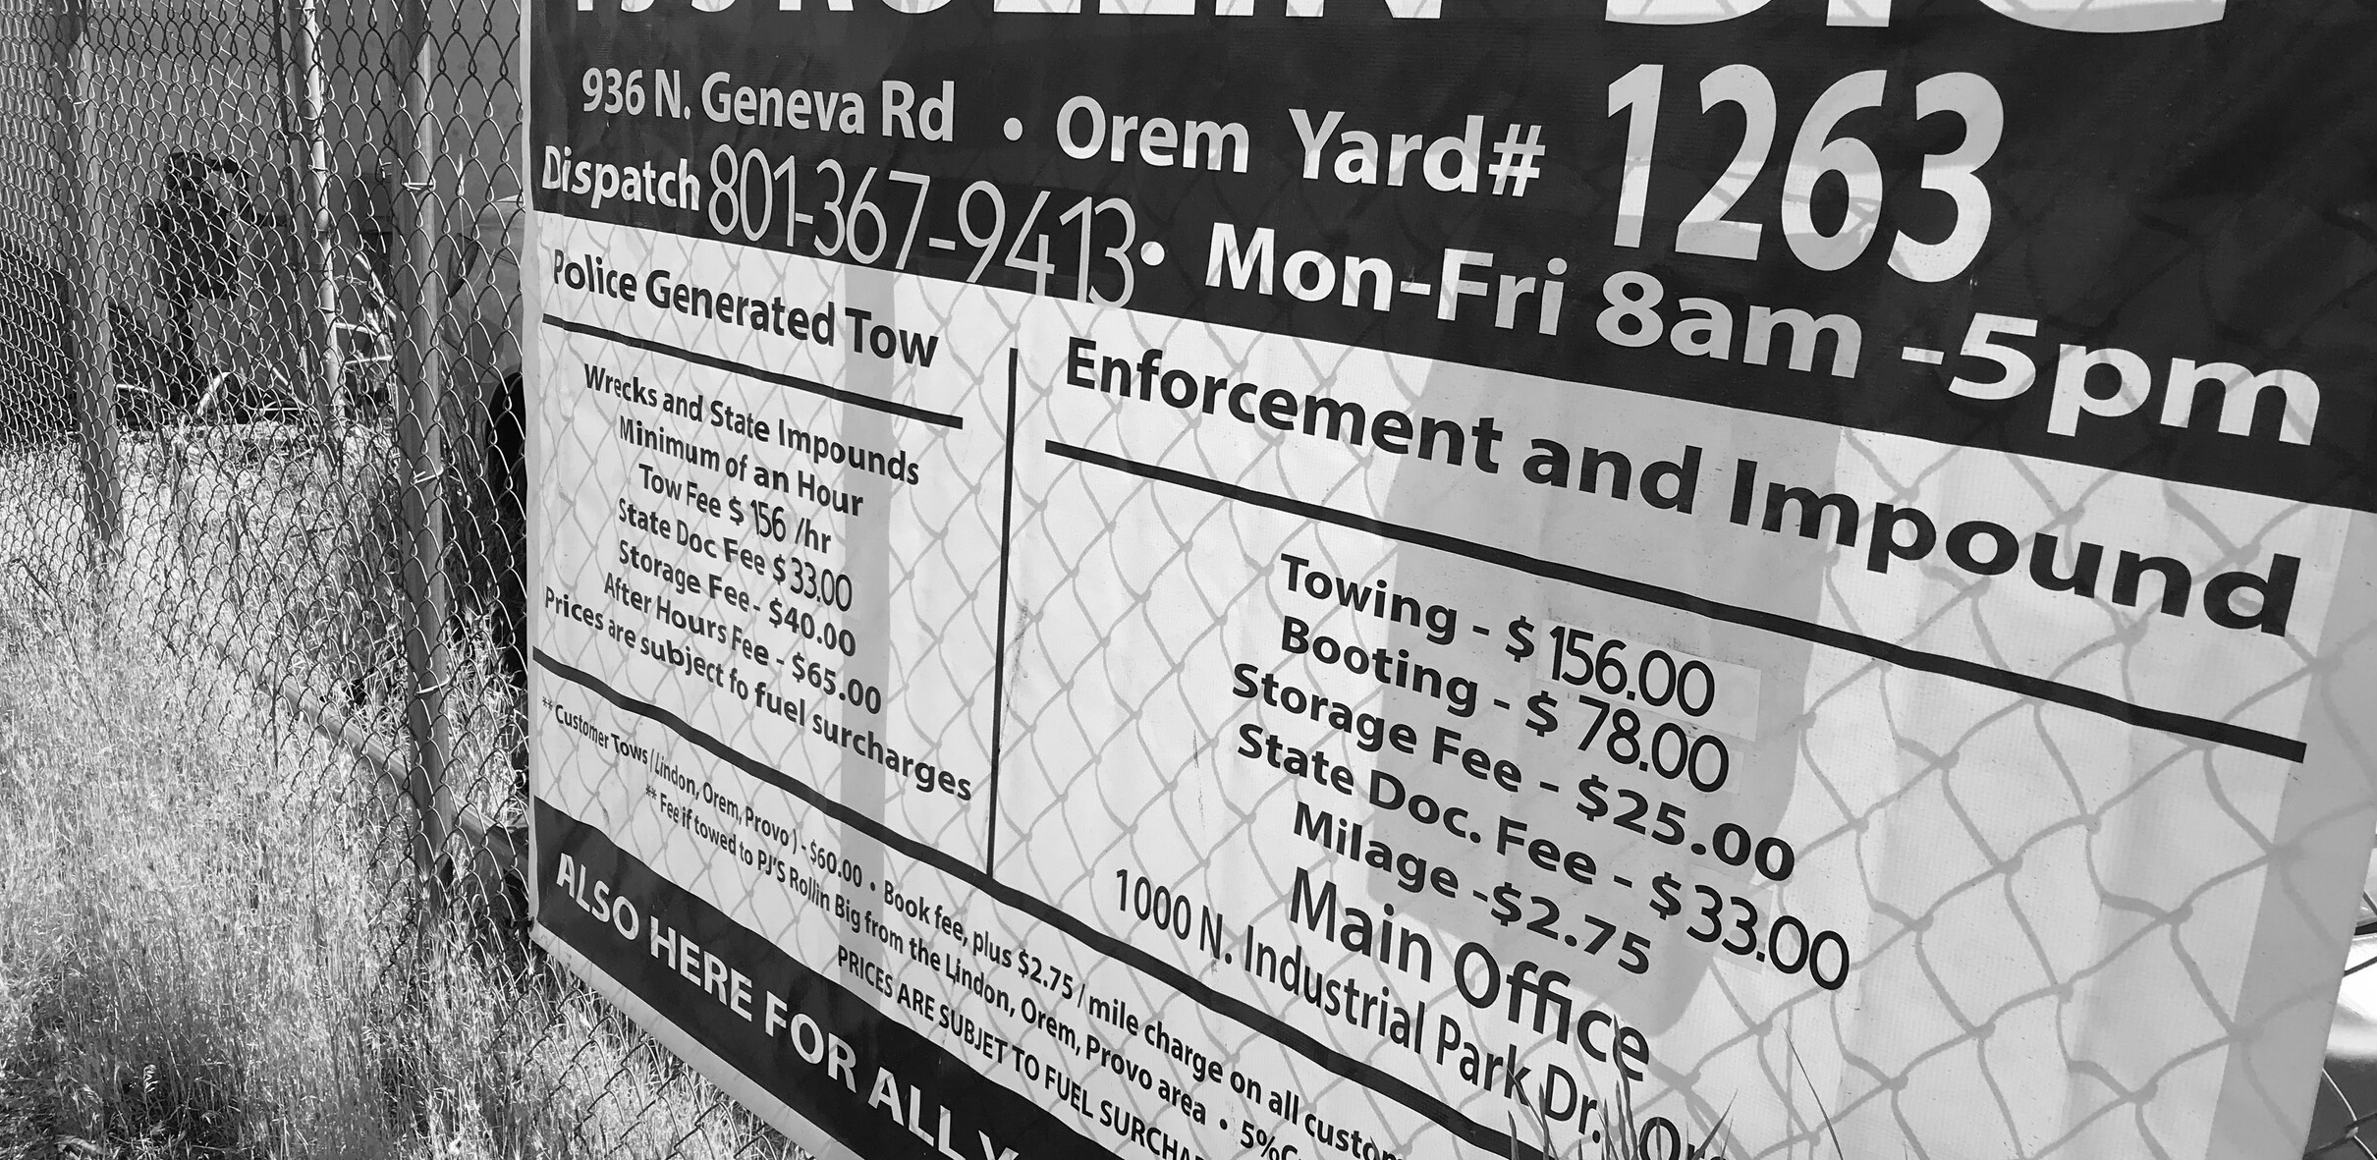
Brownfields 101

Slide 17
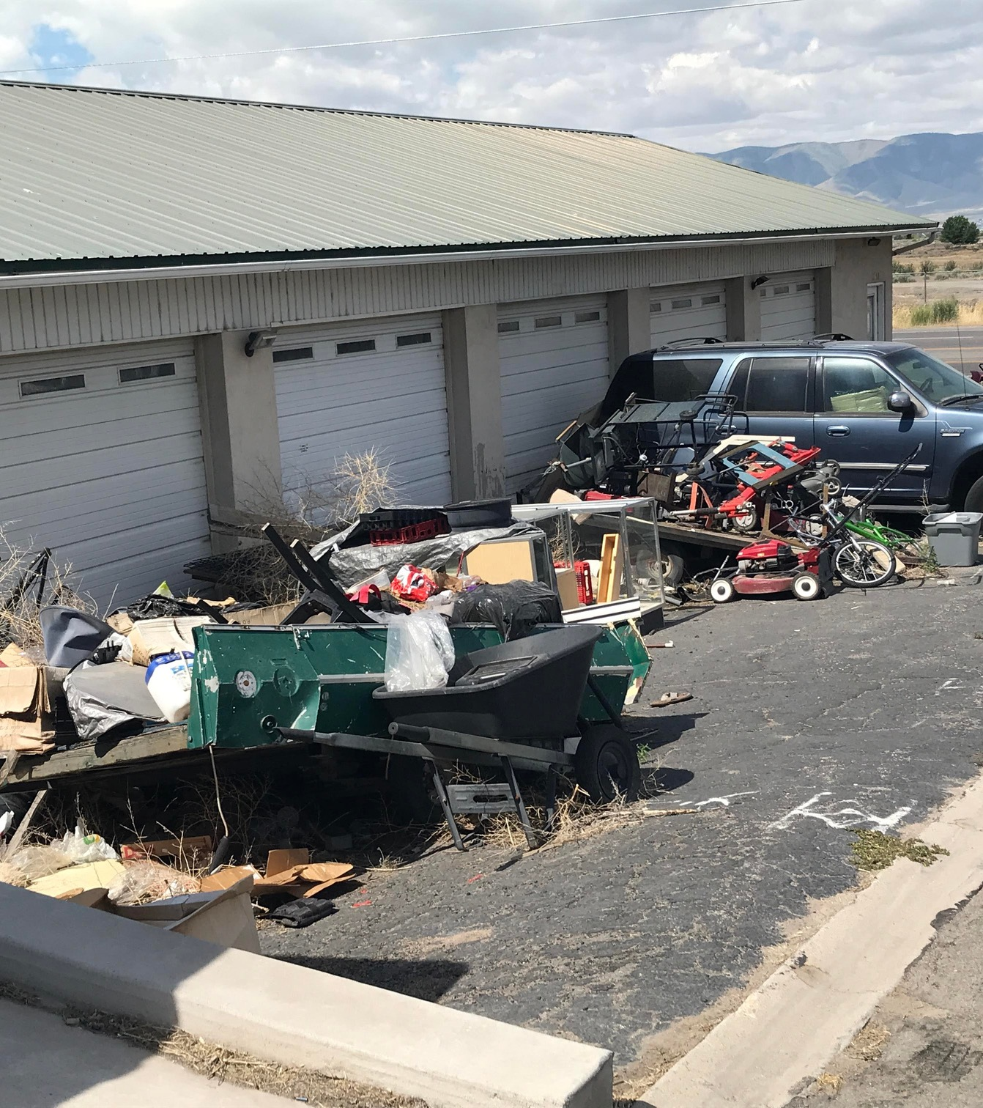
What is a brownfield?
IMAGINE OREM: REINVENTING BROWNFLEIDS
Definition:
Brownfields are generally defined as abandoned, idled, or underused industrial or commercial facilities where expansion or redevelopment is complicated by real or perceived environmental contamination.

Slide 18
What is a brownfield?
Brownfields include areas such as:
IMAGINE OREM: REINVENTING BROWNFLEIDS
Because of real or perceived pollution conditions, now sit idle and undeveloped due to cleanup costs that may have been prohibitively expensive in the past.
a former dry cleaning facility
an abandoned corner gas station
an old steel plant

Slide 19
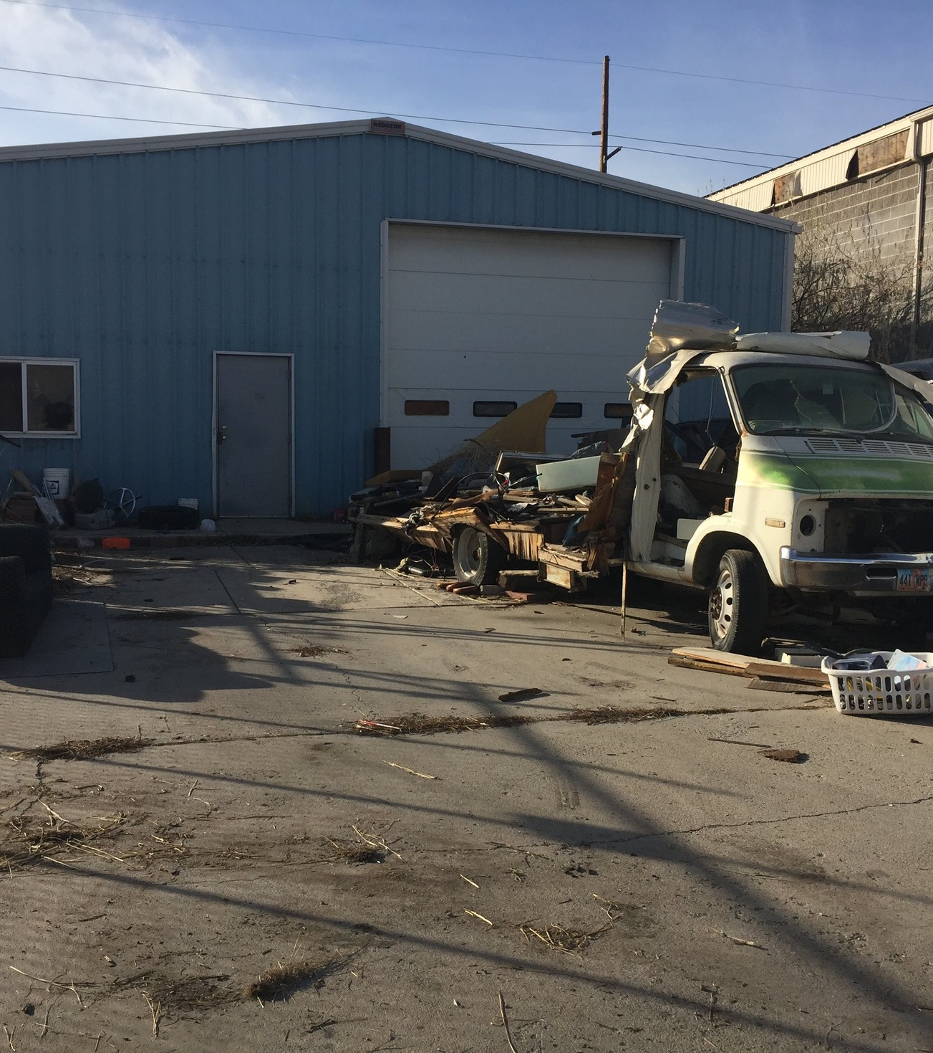
What is a brownfield?
IMAGINE OREM: REINVENTING BROWNFLEIDS
The EPA Brownfield Assessment Grant provides Orem the opportunity to:
Complete assessment of these sites
Identify contaminants present
Rule out perceived pollution concerns

Slide 20
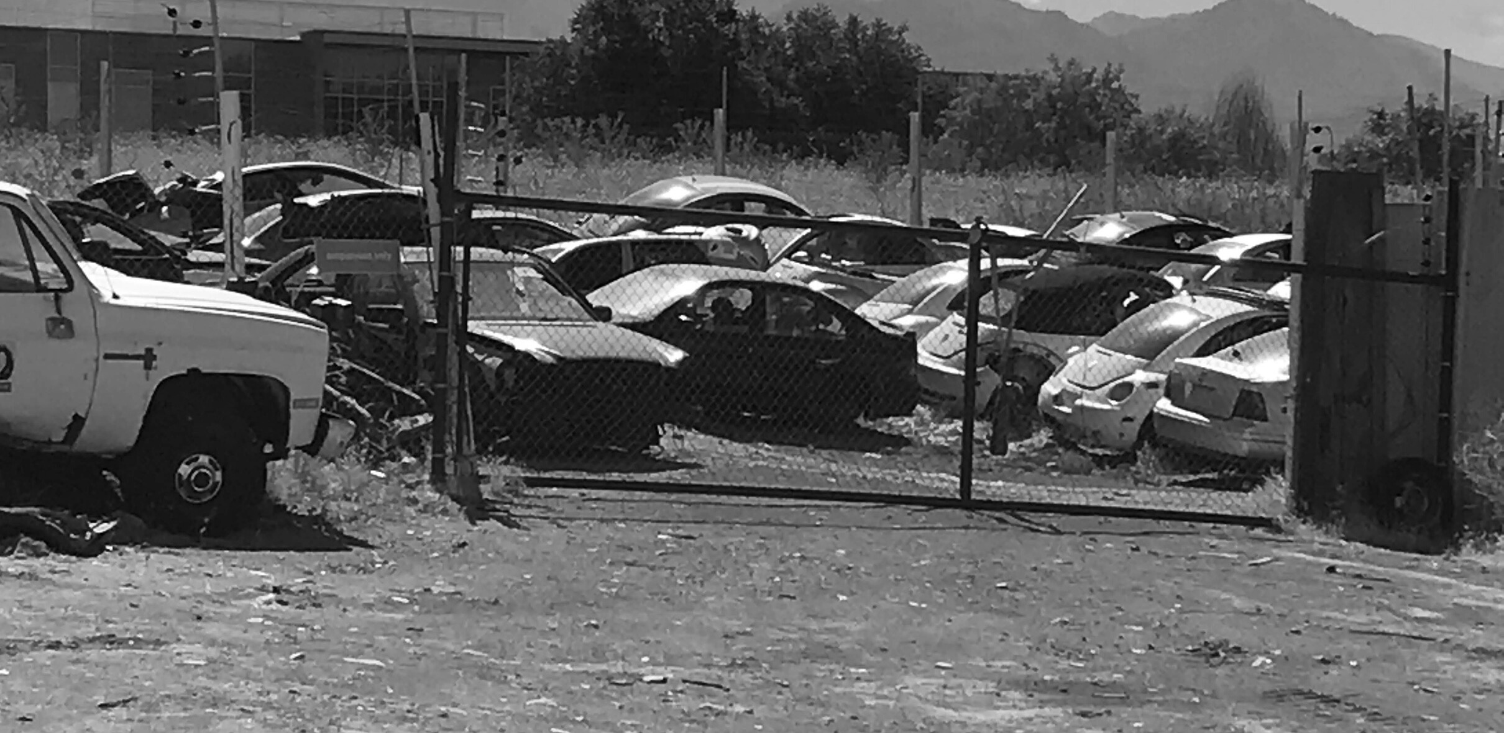
Eligible Uses of
Grant Funds

Slide 21
Eligible Activities
Brownfield Inventory
Site Assessment
A comprehensive inventory of all sites on Geneva Road and State Street that meet the definition of a brownfield
Analysis of site history and current conditions to understand the nature and extent of contamination, if present
IMAGINE OREM: REINVENTING BROWNFLEIDS
Community Outreach
Planning for Cleanup and Redevelopment
Meeting with community partners and stakeholders to share and receive information
Working with property owners and the public to plan for remediation of contamination and redevelopment of site

Slide 22
Phase I
Purpose: To determine if there may be potentially contaminated areas that require further investigation.
Action: Perform a site reconnaissance visit, conduct interviews and complete a desk-top study to determine prior and current site usage.
Site Assessment
Phase II
Purpose: Confirm the presence or absence of contamination (what and where).
Action: Sample the soil, groundwater, or other features such as tanks, drums or building materials to determine if contaminants are present.
IMAGINE OREM: REINVENTING BROWNFLEIDS
Phase III
Purpose: Delineate the contamination – how deep and wide it is, whether there is limited contamination or if it is extensive.
Action: Conduct soil and groundwater analysis to determine the risk associated with the contaminants. The results may be used to develop a remedial action workplan.

Slide 23
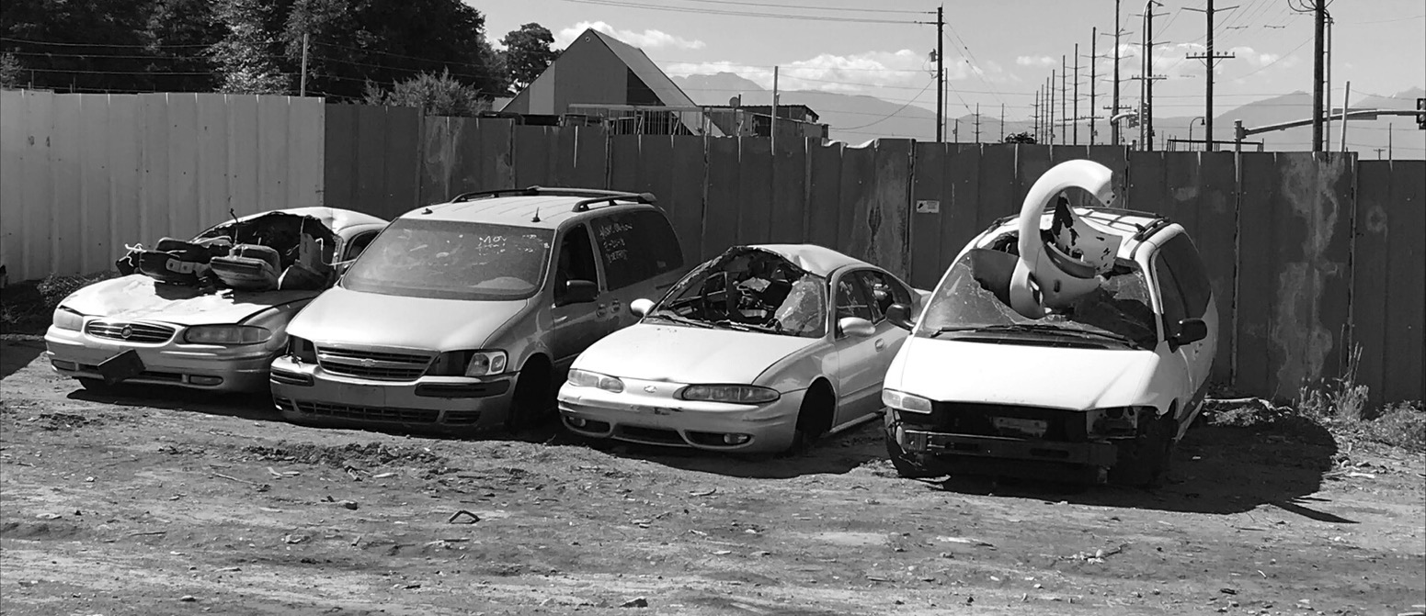
HAZARDOUS SUBSTANCES
Sites with the presence or potential presence of hazardous substances, pollutants or contaminants, including but not limited to:
Historic fill
Heavy metals
Polychlorinated biphenyls (PCBs)
Polynuclear aromatic hydrocarbons (PAHs)
Volatile organic compounds (VOCs)
Asbestos
IMAGINE OREM: REINVENTING BROWNFLEIDS
Eligible Contamination
PETROLEUM
Orem’s EPA grant provides funding for the assessment of both Hazardous Substances and Petroleum.
Sites with the presence or potential presence of petroleum or a petroleum product, including auto uses such as gas stations and auto repair, or sites with above ground or underground storage tanks, pending UDEQ approval

Slide 24
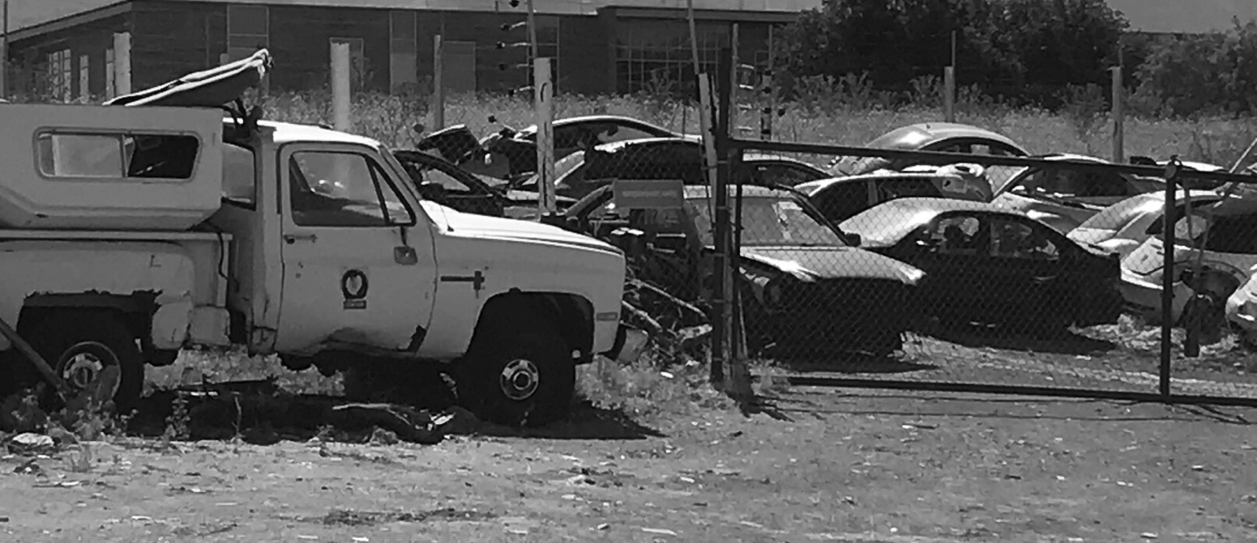
CAN BE PUBLICLY OR PRIVATELY OWNED, BUT
The City, as the grant applicant/recipient, has not dispensed or disposed of or owned the property during the dispensing or disposal of any contamination at the site.
The City, as the grant applicant/recipient, did not exacerbate the contamination at the site and took reasonable steps with regards to the contamination at the site.
Properties subject to enforcement action associated with environmental contamination are not eligible.
IMAGINE OREM: REINVENTING BROWNFLEIDS
Eligible Sites
Key information to keep in mind when considering whether a site is eligible for this program

Slide 25
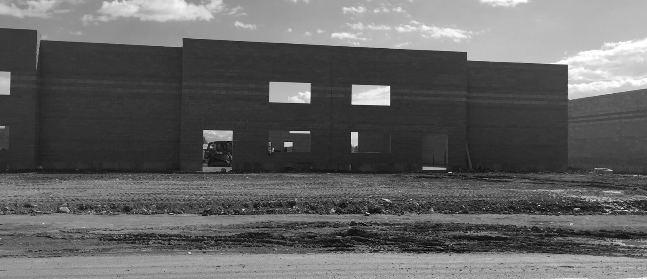
HOW THIS GRANT CAN HELP
Many available properties for sale on Geneva Road and State Street are potentially contaminated.
There is a tendency for people to develop where it’s easiest first before developing in more difficult or expensive sites, such as brownfield sites.
Many developers said they did not pursue sites on Geneva because of the time and costs involved with conducting the necessary assessment and cleanup.
Banks require an environmental site assessment to be completed in order to provide financing for a purchase.
IMAGINE OREM: REINVENTING BROWNFLEIDS
Challenges to Redevelopment
Brownfield assessment grant funding can help overcome many common obstacles to redevelopment

Slide 26
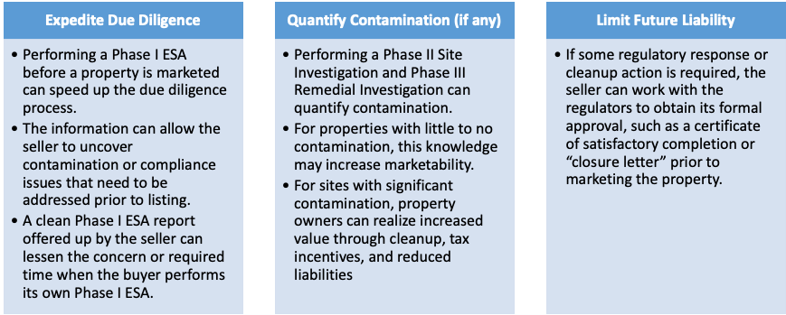
Benefits to Property Owners
IMAGINE OREM: REINVENTING BROWNFLEIDS

Slide 27
The City's goals for assessment:
IMAGINE OREM: REINVENTING BROWNFLEIDS
CONDUCT PHASE I ENVIRONMENTAL SITE ASSESSMENTS
CONDUCT PHASE II (SITE INVESTIGATION)
CONDUCT PHASE III INVESTIGATION (REMEDIAL INVESTIGATION)
Target: 4 Sites
(3 Hazardous /
1 Petroleum)
Target: 8 Sites
(6 Hazardous /
2 Petroleum)
Target: 3 Sites
(2 Hazardous /
1 Petroleum)
Cleanup and redevelopment costs are not eligible

Slide 28
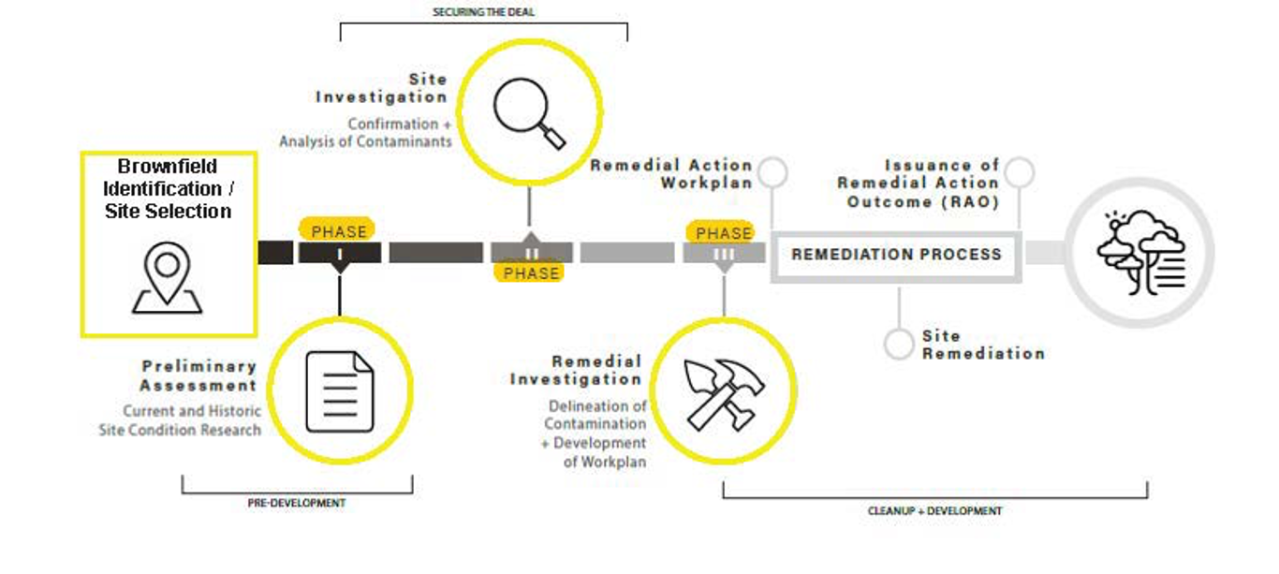
Long-term implementation
IMAGINE OREM: REINVENTING BROWNFLEIDS
No Further Action Determination

Slide 29
Next Steps

Slide 30
Project Timeline
IMAGINE OREM: REINVENTING BROWNFLEIDS
Summer 2020
Fall 2020
Winter 2020
Spring 2021
Fall 2022
Windshield survey, brownfield inventory, development of Quality Assurance Project Plan
Advisory Committee and Public Meetings and launch of project website
Continued public outreach and engagement with interested property owners; screen eligible sites for participation.
Begin environmental site assessments and provide project updates on website
Project Conclusion

Slide 31
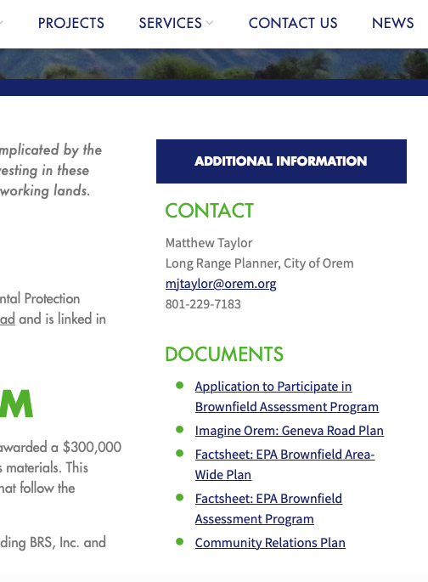
To Apply
Program Application is available on the project website at brsinc.com/orem
IMAGINE OREM: REINVENTING BROWNFLEIDS
A link to the application is on the toolbar.
If you are interested in having an assessment completed in spring 2021, please submit an application by 12/1.

Slide 32
Frequently Asked Questions
IMAGINE OREM: REINVENTING BROWNFLEIDS
WHO REVIEWS THE APPLICATIONS?
HOW ARE THE APPLICANTS NOTIFIED?
HOW LONG WILL THE ASSESSMENT TAKE?
WHAT IS THE COST TO THE PROPERTY OWNER?
Both Orem and EPA review the applications. For petroleum sites, UDEQ will also review.
Selected applicants will receive a confirmation letter or email within three weeks of the receipt of the application to schedule a kick-off call.
Upon approval of the application, assessment activities will be initiated within 30 days of the kick-off call.
There is no cost to the property owner to participate in this program.

Slide 33
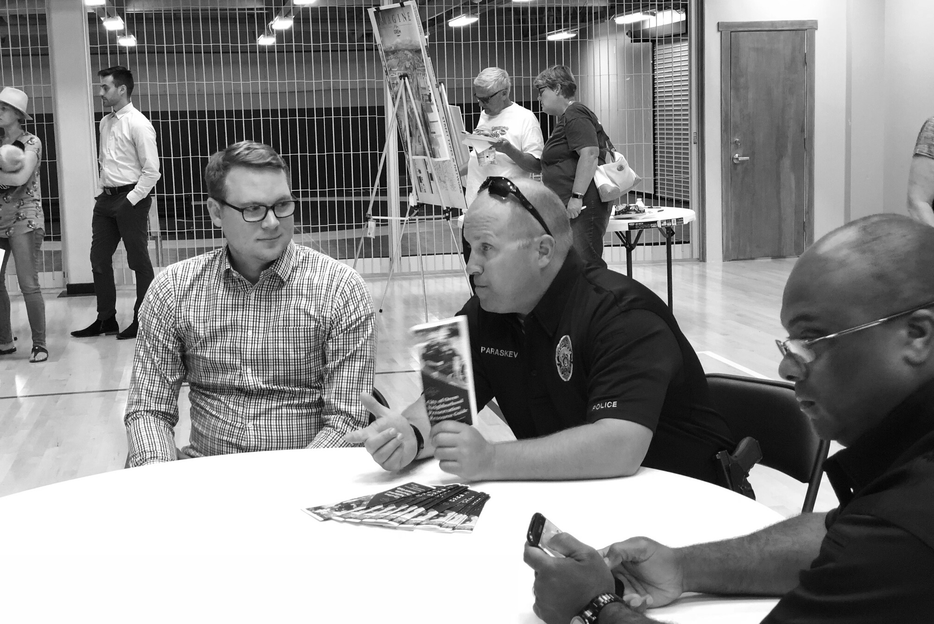
How can I get more info?
For questions and more information
PROJECT WEBSITE
brsinc.com/orem
IMAGINE OREM: REINVENTING BROWNFLEIDS
PHONE NUMBER
(801) 229-7267
EMAIL ADDRESS
mjtaylor@orem.org

Slide 34
Next Steps
Geneva Road Re-zoning
IMAGINE OREM: REINVENTING BROWNFLEIDS
IMAGINE OREM: GENEVA ROAD POSTER

Slide 35
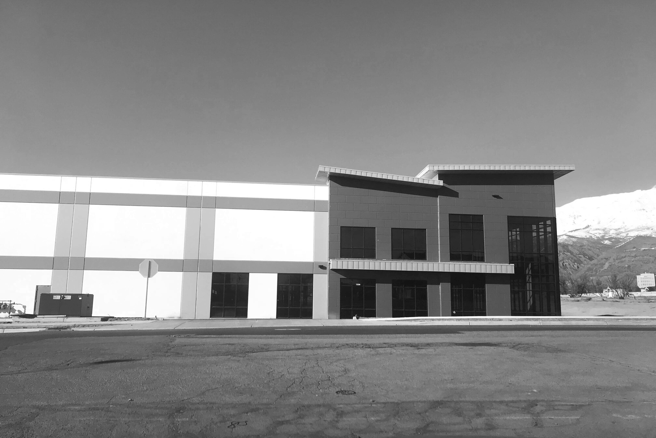
Thank you!

