Slide 1
EPA BUILDING BLOCKS FOR REGIONAL RESILIENCE
FUNDING STRATEGIES
.
WORKSHOP #3
Notes:
Welcome and very brief background on the whole project for any new attendees.

Slide 2
Recap Workshops 1 & 2
Making the Business Case for Resilience
Small Group Exercise
Wrap-up & Next Steps
FUNDING FOR RESILIENCE
And Workshop Wrap-Up
EPA BUILDING BLOCKS FOR REGIONAL RESILIENCE
Notes:
Review agenda for the workshop.

Slide 3
SOUTHERN MINNESOTA
Recap from Workshops 1 & 2
EPA BUILDING BLOCKS FOR REGIONAL RESILIENCE
Notes:
Jen Davis.
Recap what was captured in Workshop 1
Thom Peterson and Kenny Blumenfeld and Nicole Griensewic all discussing increasing risks to the region, and the links between flood disasters, farms, watershed health, and economic resilience. Set the stage for moving from good plans to action.
Participants included county planners and public works, Sen. Klobuchar’s office, watershed groups, soil and water conservation agencies, city managers, emergency managers, state agencies (DOT, Dept. of Ag, DNR, Emergency Mgmt, Pollution Control), and federal agencies (US Army Corps, FEMA, NOAA, USDA).
Workshop 2 summary on next slide

Slide 4
Break-out Rooms
Manage tile drainage during extreme precipitation events.
Reduce stormwater runoff through nature-based solutions such as vegetative buffers.
Reduce tillage by encouraging alternative residue management methods such as cover crops and crop rotation.
Mitigation in flood-prone areas and restore flood plains.
Promote water harvesting, collection and storage.
EPA BUILDING BLOCKS FOR REGIONAL RESILIENCE
Notes:
1. Mostly spent time getting to know one another and starting to really discuss this as an issue. It’s a complex topic b/c privately held land and a touchy subject. Need more follow-up on this topic, and really needs our focus.
2. Stormwater runoff
Education. Model best practices. Restore drained wetlands. May be helpful to offer tax incentives or credits, but must align with core ag operations.
3. Cover crop
Programmatic, Plans, Education, Project Planning, New initiatives.
Increased cost-share funding, peer-to-peer learning
SWCDs or Watershed p’ship to lead
Costs: SWCDs now offer $25-40/acre for cover crops, depends on acres
Years-long to establish cover crop implementation
Longer-term and lower priority
4. Floodplain restoration: Projects only restored to pre-disaster conditions. Landslides and erosion not addressed. More local responsibility. Watersheds and Drainage Districts need to be culturally connected.
5. Higher cost and more input, so would prioritize other strategies first. Need interested volunteer landowners to receive large volumes of collected water for reuse. This is a region where we don’t need a lot of water- we get it in the form of rain. Can be a difficult public-private partnership. Think about things like MDH plumbing codes for indoor use.

Slide 5
"The most successful projects have long-term, predictable funding from a wide variety of sources."
FLOOD FUNDING 101 VIDEO & FUNDING STRATEGIES HANDOUT
EPA BUILDING BLOCKS FOR REGIONAL RESILIENCE
Notes:
Abby:
Today we’re talking about funding. Mention that Funding for Resilience is a field that is constantly changing and evolving. From new private sector investors, insurance markets and bond rating agencies, to government funding more on pre-disaster to balance out with post-disaster recovery funding (like BRIC).
Focus on regional scale, and that funding can be more difficult and requires creativity.
Introduce Headwaters and reminder about materials posted online as prep work for today’s workshop.

Slide 6
EXAMPLE: WATER STORAGE
GOAL: Increase floodwater storage to protect homes by restoring wetlands & riparian zones
WATERSHED DISTRICT
CITY
COUNTY A
COUNTY B
+
+
+
EPA BUILDING BLOCKS FOR REGIONAL RESILIENCE

Slide 7
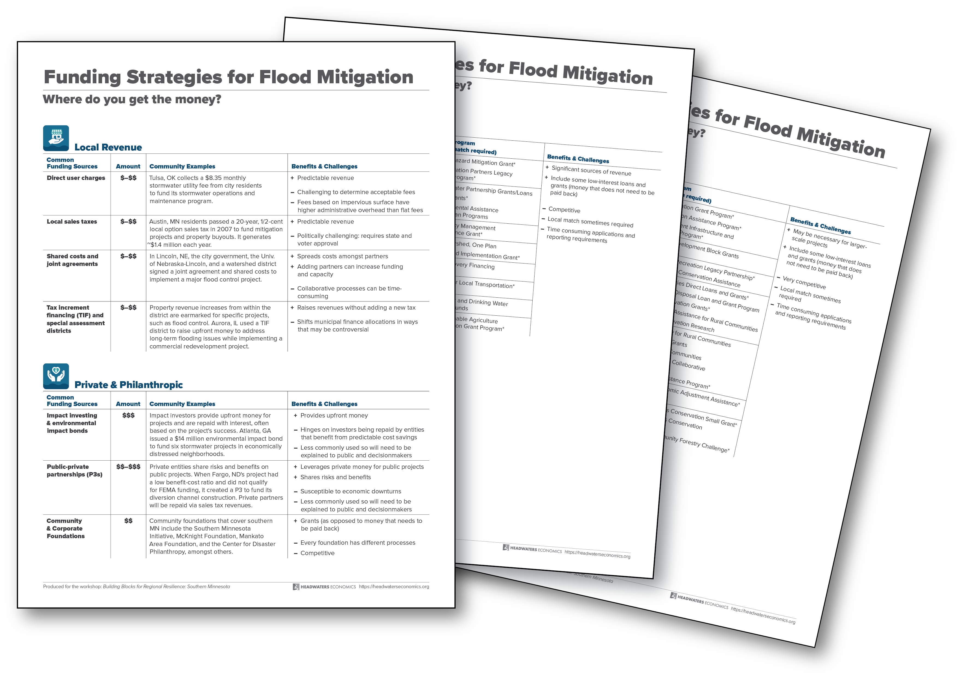
SOURCES OF FUNDING
brsinc.com/minnesota
EPA BUILDING BLOCKS FOR REGIONAL RESILIENCE

Slide 8
WHERE DO YOU GET THE MONEY?
Example project’s mix of funding sources
Local Option Sales Tax
Local Grants & Donations
EPA BUILDING BLOCKS FOR REGIONAL RESILIENCE

Slide 9
TIMELINE
Individual resolutions to
jointly apply for funding
Interlocal agreement signed
 | YR 1 |  |  |  | YR 2 |  |  |  | YR 3 |  |  |  | YR 4 |  |  |  | YR 5
Coalition planning
Relationship Building
Local Option Sales Tax
Community Foundation
Local Business Donations
County In-kind Donations
MN Environmental Assist.
FEMA BRIC Grant
EPA BUILDING BLOCKS FOR REGIONAL RESILIENCE

Slide 10
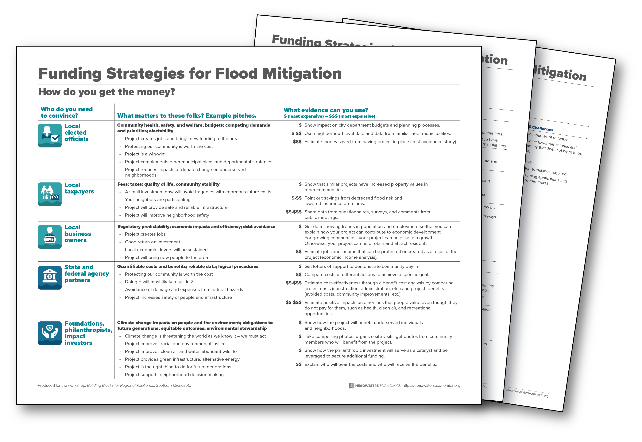
HOW DO YOU GET THE MONEY?
brsinc.com/minnesota
EPA BUILDING BLOCKS FOR REGIONAL RESILIENCE

Slide 11
GROUP EXERCISE: QUESTIONS
What matters to your funder?
How will you convince them to fund your project?
Where do you need help (gaps in data, etc)?
EPA BUILDING BLOCKS FOR REGIONAL RESILIENCE
Notes:
In intro remarks to the breakout, emphasize importance of hearing from local city and county and NGO participants who will ultimately need to develop these pitches. This should be a training exercise for them.
Feds: Jen Nelson Davis
Philanthropy: Patty Gude
State: Sharon Stephens
Local Taxpayers: Kris Smith
Local Electeds and Dept. Heads: Abby Hall
Businesses: Joel Hanif

Slide 12
REPORT OUT
What did you identify during the breakout?
Federal funding
Philanthropy
State funding
4. Local taxpayers
Local elected leaders
Businesses
EPA BUILDING BLOCKS FOR REGIONAL RESILIENCE
Notes:
Do you have a “pitch” to share?
What are your gaps in knowledge or information to be able to make the business case, e.g. jobs created, cost-benefit analysis, actual numbers?
Reactions from funders (state and federal agencies, etc.).

Slide 13
SOUTHERN MINNESOTA
Wrap-Up
&
Next Steps
EPA BUILDING BLOCKS FOR REGIONAL RESILIENCE
Notes:
Report out from Sharon about R&AT’s next steps and taking the outcome from this to the Governor and legislature. Include mention of new possible state funding for implementation.
Information about Next Steps memo from EPA (Abby)

Slide 14
What Else is Happening?
U of M’s Resilient Communities Project (RCP). Due Oct. 1.
Lidar for Southern MN– workgroup & USGS grant application.
Webinar on Adapting to Climate Change in MN Agriculture Sept. 23 from Minnesota Climate Action Partnership
Hennepin County Climate Action Plan
Unitarian Church in Mankato Green Sanctuary
EPA BUILDING BLOCKS FOR REGIONAL RESILIENCE
Notes:
Abby :
Quick selection of some of the things we’ve learned about during this workshop. Takeaway is that there is so much happening in this region to support your resilience priorities. Including funding.
U of M technical assistance: Partners benefit from applied research and technical assistance, provided by students and faculty at the University of Minnesota from a variety of departments and disciplines, to address one or more locally identified projects that advance community resilience to economic, social, environmental, or technological changes. Link to put in chat box: https://rcp.umn.edu/home/communities/apply-to-rcp
Lidar for advance mapping. Sign up to be part of the team putting together the USGS grant. Link chat: https://forms.office.com/Pages/ResponsePage.aspx?id=RrAU68QkGUWPJricIVmCjOB0a-0hNdRKs6phQr7ttDVUNU45OU5FSUpNMEZSM0ZEVDhUS1cxSjZCRy4u
Webinar link for chat box: https://umn.zoom.us/webinar/register/WN_NHqEzIFdRs-iXqv7hQxKsg
Hennepin County Climate Action Plan – looking to share best practices
Green Sanctuary Program seeks to implement 5 sustainability projects locally and looking for partners.
But tell us what else should be on our list for next steps.

Slide 15
Chat Question
Tell us about other funding opportunities, plan updates, or near-term efforts to add to the list.
EPA BUILDING BLOCKS FOR REGIONAL RESILIENCE
Notes:
Abby: Tell us what else should be on our list for next steps. We’ll track those as we talk about the Task Force next.

Slide 16
Task Force for
Southern Minnesota Resilience
LINK to sign up at BRS.com/minnesota
OR
Add your name and email to the chat box now.
EPA BUILDING BLOCKS FOR REGIONAL RESILIENCE
Notes:
Sharon and Joel:
Are you willing to serve on this task force?
MPCA will continue to be a resource to the task force.
Region Nine role as a convener/facilitator and minor participant
Sharon and Joel will help organize the first follow-up meeting.
One possible task identified in the workshop so far: Ag outreach & tile drain subgroup to study the problem and identify some potential solutions.
Another possible follow-up action: working more with Headwaters on data, analyses, or funding support.
Sign up link on the BRS website for people to volunteer for more info and involvement in this regional “task force.” Or add your name now to the chat box.

Slide 17
THANK YOU!
Sharon Stephens, MPCA: sharon.stephens@state.mn.us
Jen Nelson Davis, HSEM: jennifer.e.nelson@state.mn.us
Joel Hanif, Region Nine Development Commission: joel@rndc.org
Abby Hall, U.S. EPA: hall.abby@epa.gov
Katie-Rose Imbriano, BRS: katie-rose@brsinc.com
Alisa Goren, BRS: alisa@brsinc.com
Kris Smith, Headwaters Economics: Kris@headwaterseconomics.org
Notes:
Abby:
Remind people that materials will stay up on the site until early 2021.
We’ll also circulate the next steps memo to everyone.

